Slide 1
CSE422: Artificial intelligence
Adversarial Search
Game playing using Minimax algorithm
Asif Shahriar
Lecturer, CSE, BRACU

Slide 2
WHY Adversarial Search
So far we have seen TWO intelligent search techniques
Informed search (A-star search)
Finds the optimal path to a known goal
Local search (Hill climbing, simulated annealing, genetic algorithm)
Optimize a solution when the full search space is too large
No notion of path — only focuses on current state and neighbors
Both search techniques assume:
The world does not change unless the agent acts
There is no opponent in the search space – agent is working alone
In many real-world settings, the environment is non-deterministic and competitive
The outcome depends not only on your actions, but also on the opponent's actions
You are not just finding a path — you are outsmarting an opponent

Slide 3
Adversarial Search
A search framework used in competitive, multi-agent environments
Agents (players) take turns, and each tries to maximize their own utility (chances of winning the game or better their positions)
Standard model for two-player zero-sum games
Zero-sum: one player’s loss is the other’s gain (chess, rock-paper, 1v1 poker)
Non-zero-sum game: players may both (all) gain or lose (monopoly, team games)
Adversarial search assumes perfect information: both players have access to complete information about the state of the game
No chance (e.g., using dice) involved
Adversarial search helps an agent make the best move assuming the worst-case opponent response

Slide 4
How to PLAY a Game
A way to play such a game is to:
Consider all legal moves you can make
Compute the new position resulting from each move
Evaluate each resulting position and determine which is best
Make that move
Wait for your opponent to move
Repeat
Key problems:
Representing the “game”
Generating all legal next boards
Evaluating a position

Slide 5
Let’s play a game - 1
Suppose you and your friend both got caught doing something criminal and have been brought in for interrogation
If both deny, both get 10 years sentence
If both accept, both get 5 years sentence
If one accepts and other deny, the one who denies goes free but the one who accepts get 10 years sentence
What you gonna do?

Slide 6
Let’s play a game - 2
There are four coins and 2 players
Each player can take ONE or TWO coins
The one who takes the last coin, loses
You can choose to go first or go second
What you gonna do?

Slide 7
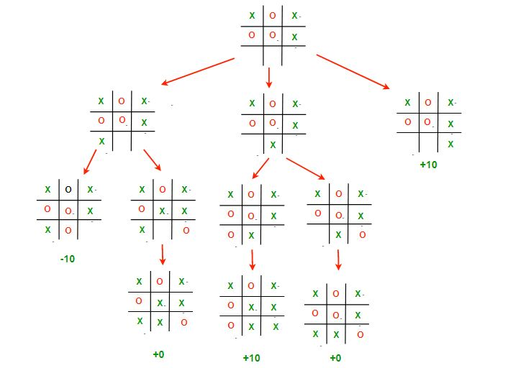
Let’s Play TIC-TAC-TOE 1

Slide 8
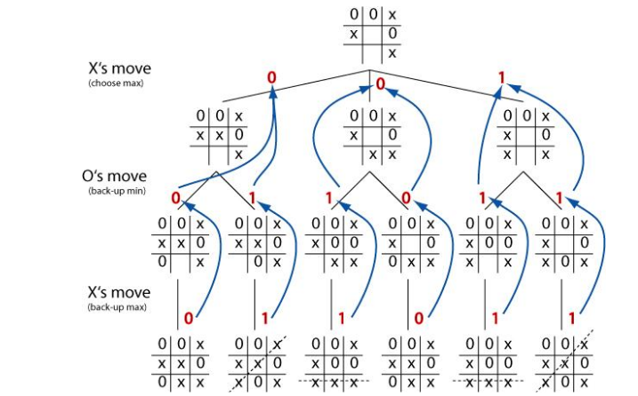
Let’s Play TIC-TAC-TOE 2

Slide 9
Evaluating a Position
Evaluation function or static evaluator is used to evaluate the “goodness” of a game position
Contrast with heuristic search where the evaluation function was a non-negative estimate of the cost from the start node to a goal and passing through the given node
The zero-sum assumption allows us to use a single evaluation function to describe the goodness of a board with respect to both players
f(n) >> 0: position n good for me and bad for opponent
f(n) << 0: position n bad for me and good for opponent
f(n) = 0: position n is a neutral position
f(n) = +infinity: win for me
f(n) = -infinity: win for opponent

Slide 10
Example Evaluation Functions
Example of an evaluation function for Tic-Tac-Toe:
f(n) = [# of 3-lengths open for me] - [# of 3-lengths open for you]
where a 3-length is a complete row, column, or diagonal
Alan Turing’s function for chess
f(n) = w(n)/b(n) where w(n) = sum of the point value of white’s pieces and b(n) = sum of black’s
Piece value: Queen = 9, rook = 5, bishop / knight = 3 (but bishop pair = 7 instead of 6), pawn = 1
Most evaluation functions are specified as a weighted sum of position features:
f(n) = w1 * f1(n) + w2 * f2(n) + ... + wn * fn(n)
Features for chess are piece count, piece placement, squares controlled, etc

Slide 11
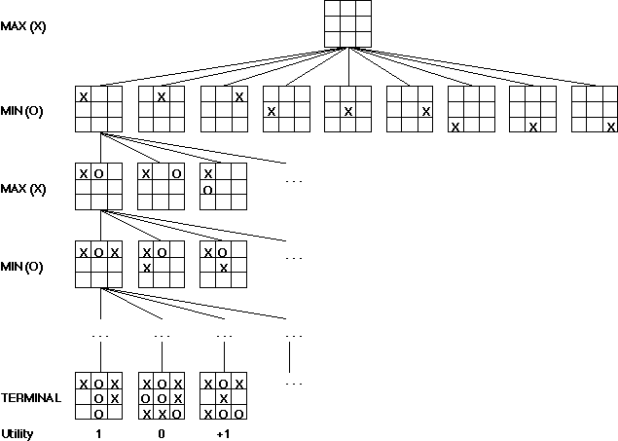
Game Trees
Problem spaces for typical games are represented as trees
Root node represents the current board configuration; player must decide the best single move to make next
Static evaluation function rates a board position. f(board) = real number with f>0 (me better), f<0 (opponent better), f=0 (equal)
Arcs represent the possible legal moves for a player
If it is my turn to move, then the root is labeled a "MAX" node; otherwise it is labeled a "MIN" node, indicating my opponent's turn
Each level of the tree has nodes that are all MAX or all MIN; nodes at level i are of the opposite kind from those at level i+1

Slide 12
Game Trees
Create start node as a MAX node with current board configuration
Expand nodes down to some depth (a.k.a. ply) of lookahead in the game
Apply the evaluation function at each of the leaf nodes
“Back up” values for each of the non-leaf nodes until a value is computed for the root node
At MIN nodes, the backed-up value is the minimum of the values associated with its children.
At MAX nodes, the backed-up value is the maximum of the values associated with its children.
Pick the operator associated with the child node whose backed-up value determined the value at the root

Slide 13
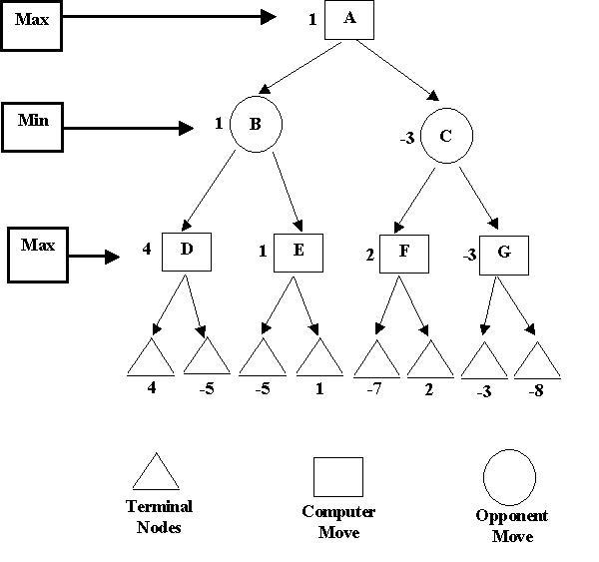
Game Trees
Positive root value suggests that MAX is in better position
MIN chooses 1 as 1 < 4
MAX chooses 4 as 4 > -5
Static evaluator values

Slide 14
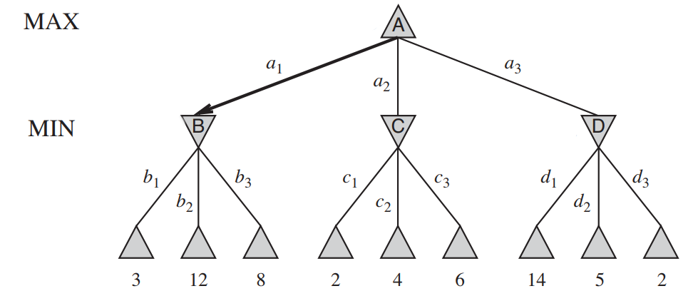
Game Trees

Slide 15
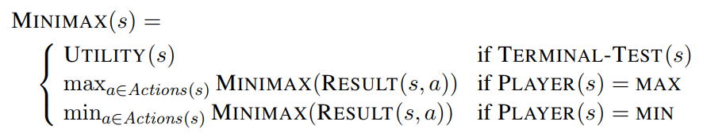
Minimax Algorithm
Complete depth-first exploration
Let depth = m, average moves available = b (i.e. branching factor)
Time complexity: O(b^{m} ), space complexity: O(bm)
O(10⁴⁰ ) in chess – making minimax impractical
Solution: Alpha-beta pruning

Slide 16
Minimax Algorithm
function minimax(position, depth, maximizingPlayer)
if depth == 0 or game over in position
return static evaluation of position
if maximizingPlayer
maxEval = -infinity
for each child of position
eval = minimax(child, depth - 1, ____)
maxEval = max(maxEval, eval)
return maxEval
else
minEval = +infinity
for each child of position
eval = minimax(child, depth - 1, ____)
minEval = min(minEval, eval)
return minEval
// initial call
minimax(currentPosition, 3, true)

Slide 17
Alpha-beta Pruning
Basic idea: “If you have an idea that is surely bad, don't take the time to see how truly awful it is.” -- Pat Winston
In other words: We DO NOT need to check ALL moves
MAX
We don’t need to compute the value at this node.
No matter what it is, it can’t affect the value of the root node.
>=2
MIN
=2
<=1
2
7
1
?

Slide 18
Alpha-beta Pruning
𝛂 (alpha) = value of best choice so far for MAX (highest value)
𝛃 (beta) = value of best choice so far for MIN (lowest value)
Each node keeps track of its [𝛂, 𝛃] values

Slide 19
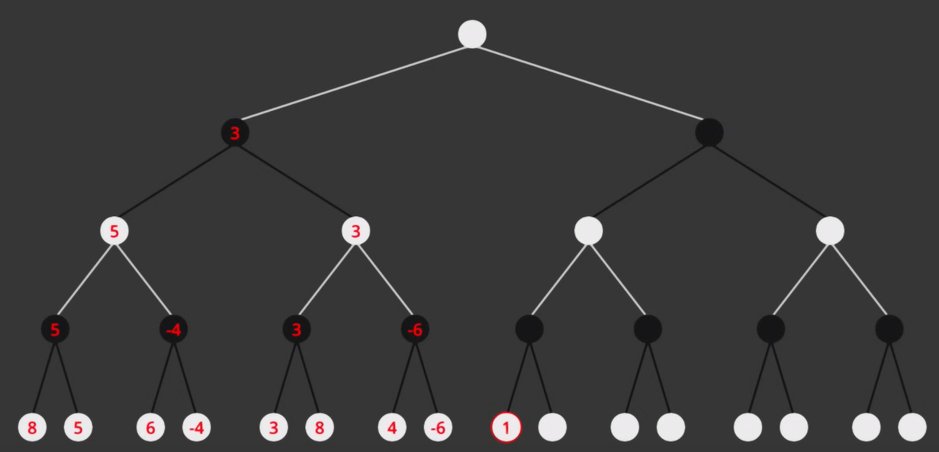
Alpha-beta Pruning

Slide 20
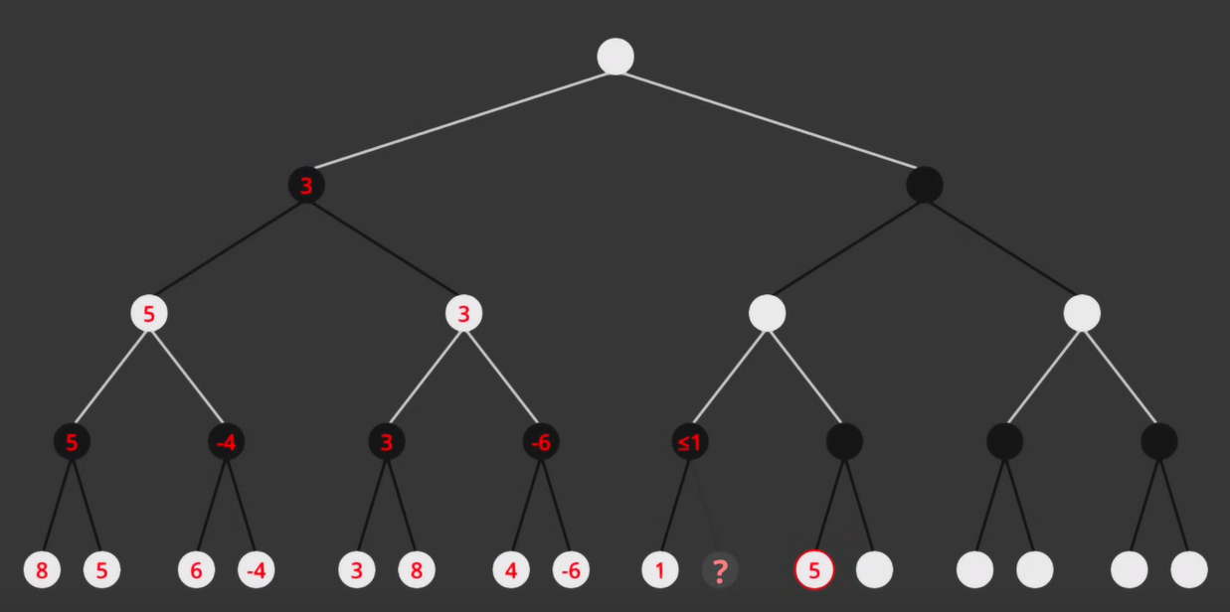
Alpha-beta Pruning

Slide 21
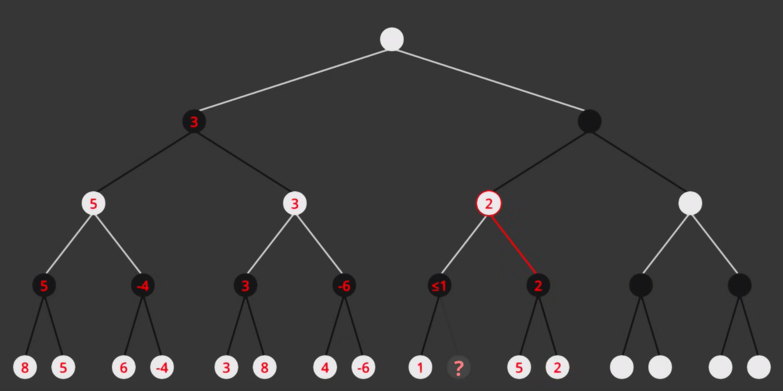
Alpha-beta Pruning

Slide 22
Alpha-beta Algorithm
function minimax(position, depth, alpha, beta, maximizingPlayer)
if depth == 0 or game over in position
return static evaluation of position
if maximizingPlayer
maxEval = -infinity
for each child of position
eval = minimax(child, depth - 1, alpha, beta, false)
maxEval = max(maxEval, eval)
alpha = max(alpha, eval)
if beta <= alpha
break
return maxEval
else
minEval = +infinity
for each child of position
eval = minimax(child, depth - 1, alpha, beta, true)
minEval = min(minEval, eval)
beta = min(beta, eval)
if beta <= alpha
break
return minEval
// initial call
minimax(currentPosition,3,-∞, +∞,true)

Slide 23
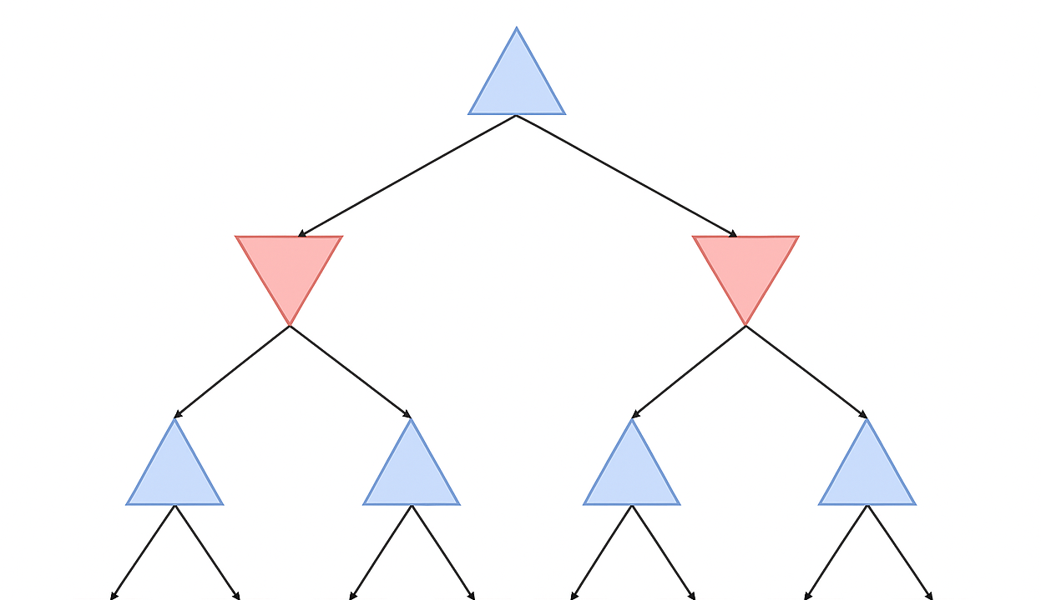
Alpha-beta Pruning Simulation - 1
MAX
MIN
MAX
-1
3
5
1
–6
-4
0
9

Slide 24
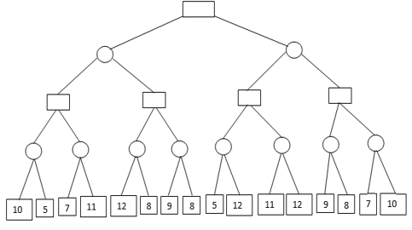
Alpha-beta Pruning Simulation - 2

Slide 25
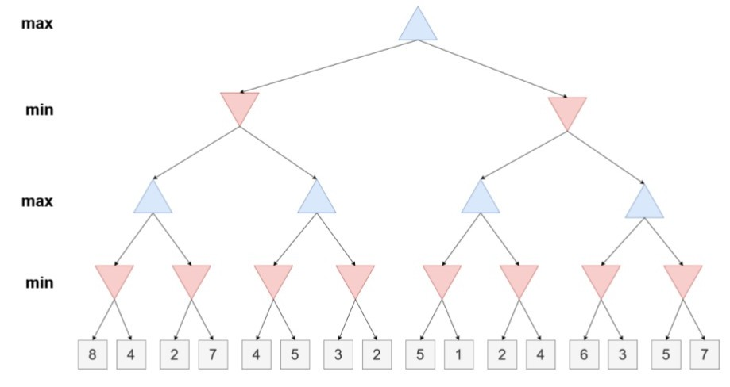
Alpha-beta Pruning Simulation - 3

